Slide 1
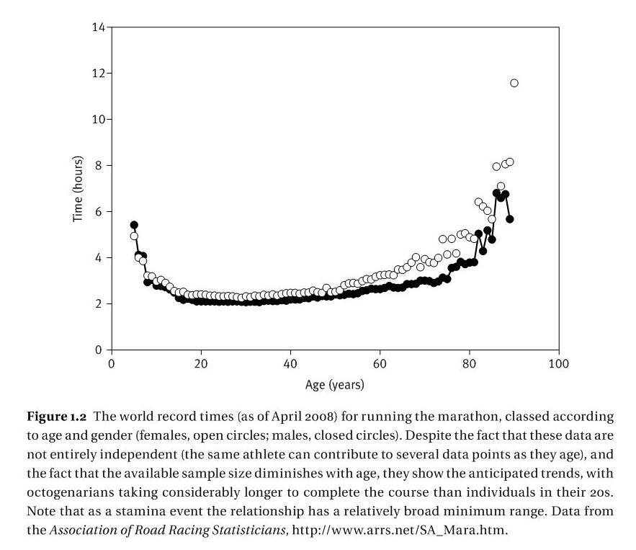
The evolution of senescence

Slide 2
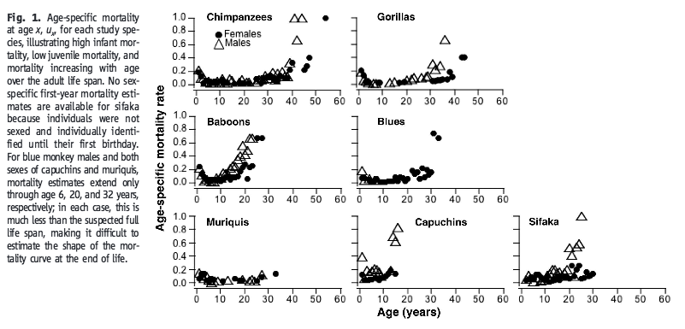
Bronikowski et al 2011. Science

Slide 3
Gompertz-Makeham mortality model
μ_{t} age-dependent mortality rate
t age
c the extrinsic mortality rate
λ a constant multiplier of the mortality rate
γ affects the rate of increase in mortality with age
Fox et al. 2001. Senescence in Evolutionary Ecology: Concepts and case studies. Oxford University Press.

Slide 4
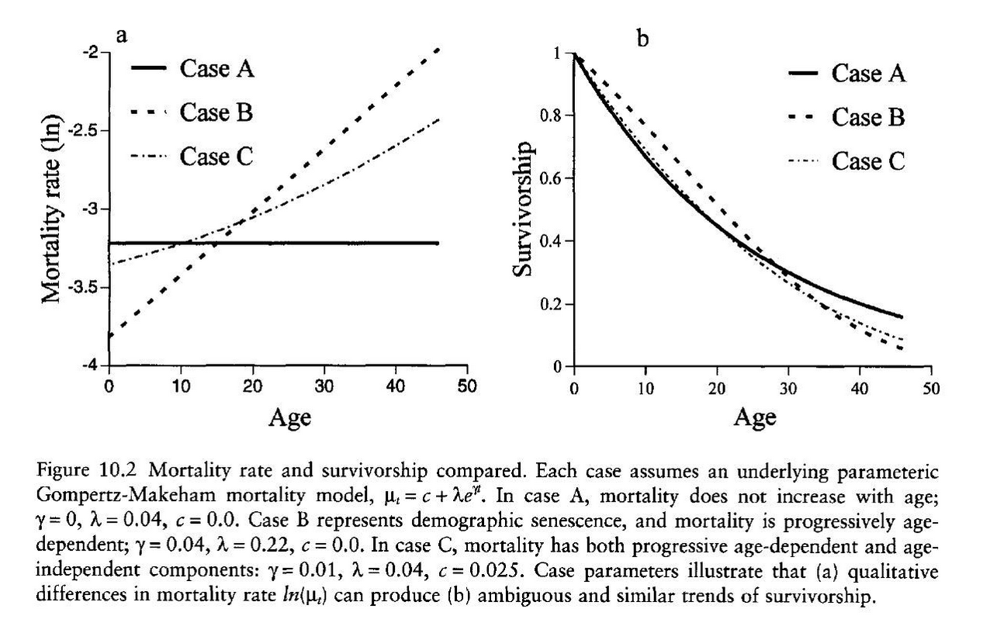
Fox et al. 2001. Senescence in Evolutionary Ecology: Concepts and case studies. Oxford University Press.

Slide 5
Evolution of senescence
Mutation accumulation: Late-acting deleterious effects persist because there is no selection pressure to remove them
Antagonistic pleiotropy: Late-acting deleterious genes have earlier acting benefits
Damage accumulation/Redundancy theory: mortality is avoided if there is at least one functioning copy of a gene
Laird and Sherratt 2009. JEB.

Slide 6
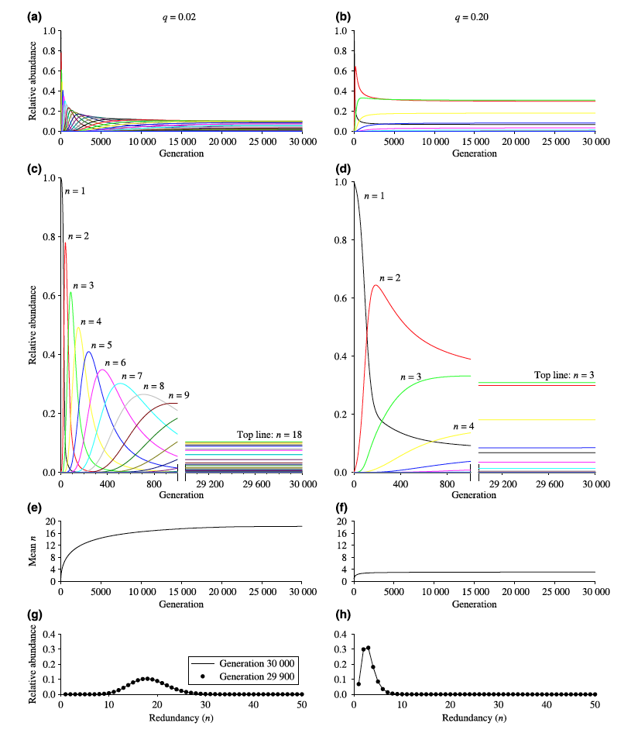
Laird and Sherratt 2009. JEB.

Slide 7
Practice questions
We showed that evolution can favor the allele with the highest intrinsic growth rate. What were the assumptions of this argument?
What is senescence?
Give two hypotheses that can explain why individuals will not evolve to live forever.

Slide 8
Age and size at maturity
Recommended reading:
Fox et al. 2001. Chapter 8 Age and Size at Maturity. In Evolutionary Ecology: Concepts and case studies. Oxford University Press. p101

Slide 9
Trade-offs in age and size at maturity
For any individual only two of three traits, growth rate, development time and adult body size are independent

Slide 10
Fecundity
Large adult size correlated with increased fecundity for 10/11 species
The relationship between development time and fecundity is unresolved (conflicting results/few data)

Slide 11
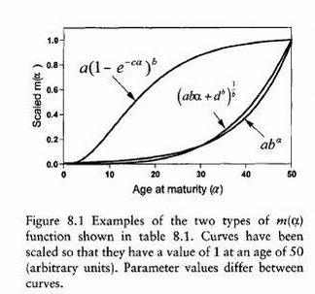

Slide 12
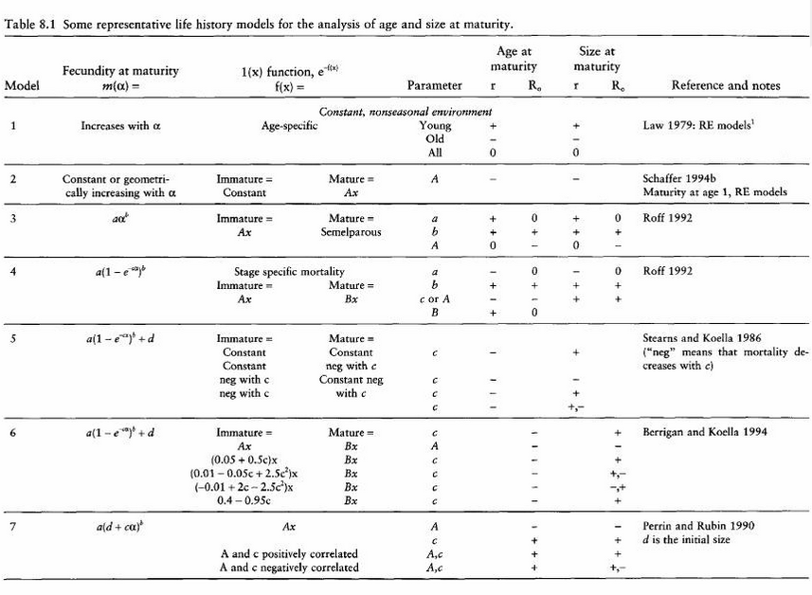

Slide 13
Increasing mortality in older age groups decreases the age of maturity
The effect of varying growth depends on how growth is included in the model

Slide 14
Practice question
What factors affect the age and size of maturity of an organism?

Slide 15
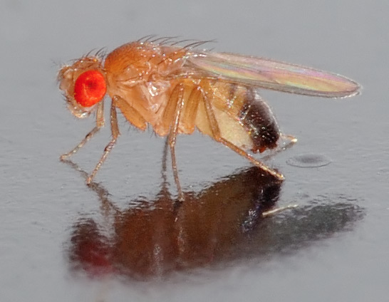
Evolution of age and body size in Drosophila
Photo credit: André Karwath

Slide 16
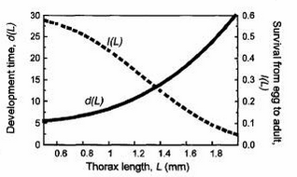
Body size and development time are correlated
D(L): development time
L: body length (size)

Slide 17
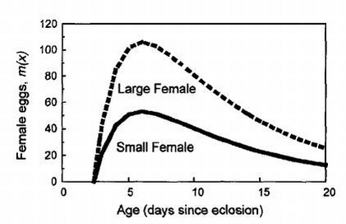
Fecundity and body size are correlated
m(x): fecundity
x: age
m₀ = m₄L^{m5} (were L is length - size)

Slide 18
Increased development time leads to decreased pre-adult survival

Slide 19
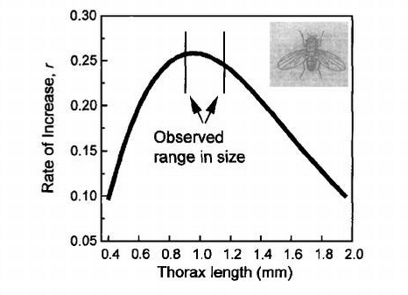
Given these assumptions what body size maximizes r?

Slide 20
Summary
Fecundity and body size are positively correlated
Only two of the three traits, growth rate, development time and adult body size are independent
Larger body sizes can mean longer development times/slower growth rates leading to longer pre-adult periods and higher pre-adult mortality

Slide 21
Summary
The relationships between age and fecundity and age and mortality determine determine the optimal age at maturity

Slide 22
Summary
Body size at maturity
Fecundity
development time
(age at maturity)
Pre-adult mortality

Slide 23
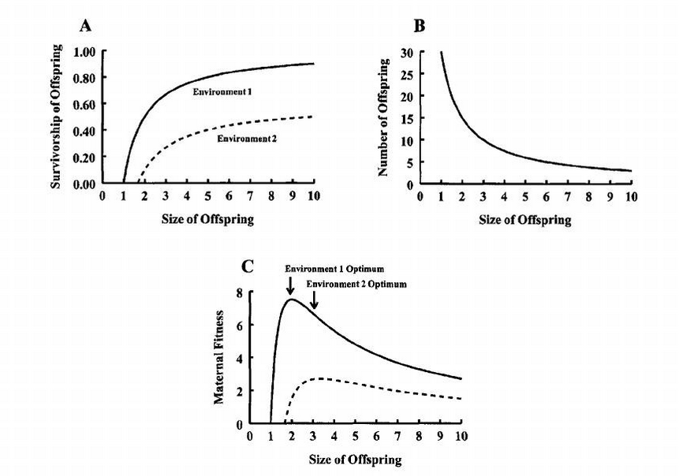
The evolution of offspring size and number (Smith-Fretwell model)

Slide 24
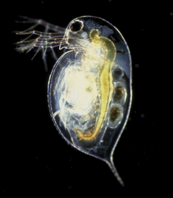
Variability in offspring size
Geographic clines in offspring size are common: Drosophila egg size increases with latitude
Larger offspring reduces the variability in survival: cladocerans lay larger eggs when food availability is low
Offspring size is correlated
with maternal age
Photo credit: Paul Hebert

Slide 25
Smith-Fretwell model assumptions
Does not describe how reproductive effort evolves
Does not consider physiological or morphological constraints (e.g. brood pouch size as a constraint)
Assume fecundity is maximized (ignore effect on success reproductive ability)
Ignores sibling conflict, parental care (large clutches difficult to care for)

Slide 26
Summary
Trade-offs can explain the evolution of intermediately valued traits, i.e.
antagonistic pleiotrophy
pre-adult survival vs. fecundity at maturity
offspring number vs. survivorship

